Slide 1
Colorize Images
Programming club:
DIY Projects

Slide 2
Task Overview
Our aim is to get colorize image from a grayscale image using GANs (specifically DCGAN)
on Image Colorization dataset from kaggle.

Slide 3
Generative Adversarial Network
A GAN is composed of two smaller networks called the generator and discriminator
Generator
Discriminator
Generator task is to generate images. It takes input as a noise latent and tries to generate images that can fool discriminator so that it classifies it as real (1).
Discriminator task is to distinguish
between real and generated images.
It takes input of real images and generated images, and learns to give output 0 for generated and 1 for real.
Deep Convolutional Generative Adversarial Networks (DCGAN) are a type of GAN that uses convolutional layers.

Slide 4
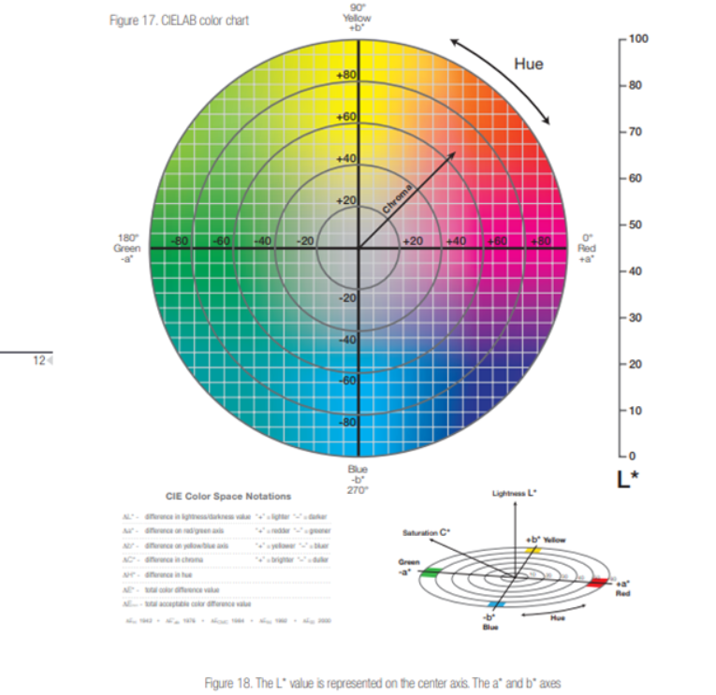
LAB color space
It is a 3d color space where
L: represents luminance
A: represents red(+), green(-) value
B: represents yellow(+), blue(-) value
In our model we will take L channel input
for generator and it will generate
image in LAB color space.

Slide 5
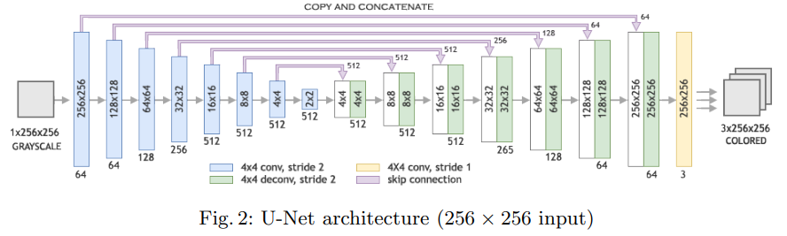
Model Architecture
I used Image Colorization using Generative Adversarial Networks paper’s architecture as reference and modified it as per my image size(256*256 in paper and 224*224 in my dataset) and my workability.
This architecture is called U-Net, where skip connections are added between layer i and layer n-i.

Slide 6
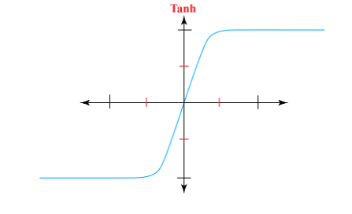
Generator
I used the same U-Net architecture as my base line.
In downsampling layer I added Conv2d, Batchnorm2d and LeakyRelu
and for upsampling I added ConvTranspose2d, Batchnorm2d and Leakyrelu.
In forward of upampling i added skip connection to the correspondance upsampling layer by concatenating them.
At last I used upsample to match the input size because discriminator has to take it as input and finally a tanh activation function.
tanh: It is a hyperbolic function which 0utputs values in range [-1,1]
tanh(x)= (e^x+e^−x)/(e^x−e^−x)​
Why tanh?
I normalized my data in range [-1,1]
so the real image input for discriminator is [-1,1] so to match it I used this and it is found suitable for GAN model.

Slide 7
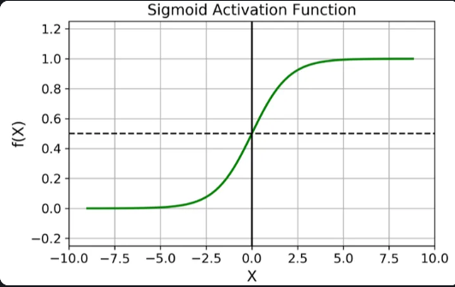
Discriminator
I don’t used the upsampling layer in discriminator because, I observed while training discriminator was going dominant( learns too fast because of complex architecture)
so I only used same downsampling layer as generator followed by MaxPool2D, Flatten, Linear and sigmoid.
Sigmoid: It is a non-linear activation function which outputs in range [0,1]
σ(x)=1/1+e^−x​
Why sigmoid?
The discriminator has to output 0 for generated images and 1 for fake images so sigmoid works best for it.

Slide 8
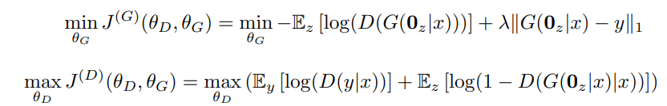
Cost Functions
discriminator: It has to maximize this function where Ey[log(D(y|x))] encourages to real image output close to 1 and Ez[log(1-D(G0z|x)|x))] encorages to output 0 for generated images. I added One Sided Label Smoothing of 0.1 as regularizer in real outputs so that discriminator doesn’t become too confident.
Generator: It has to minimize this cost function where -Ez(D(G(0z|x)))] encorages to output 1 (generator is trying to fool discriminator) and the second term L1 norm regularization to force the generator to produce images similar to real images. I used lamda = 100 because it worked best.

Slide 9
Math behind Cost function
Discriminator: D(y|x) is the output of real images by discriminator and we apply a log function after it because it is better for optimization so for discriminator to work better D(y|x) should produce 1(max) for classifying real images to be real so we have to maximize it, as for generator’s output we subtract the output from 1 because we want to force discriminator to output 0 for generated images.
Generator: G(0z|x) is the output from generator we pass this output through discriminator which outputs values between [0,1] for generator to fool discriminator this output should be 1 and the second term y is the real images we subtract it from generated images to measure how far the generated images are from real and add a regularization term (lambda) to give more weightage to it(100 in my case). so overall we have to minimize the distance and maximize the fooling of discriminator so we add a negative sign before it and minimize the overall function.

Slide 10
Problems and tackling strategies
1 I used the learning rate of 0.0002 but after 100 epochs my loss started diverging from the minima.
Sol- I added reduce on plateau scheduler to decrease the learning rate when it is not decreasing
2 After 150 epochs my discriminator stated dominating the generator it’s loss became close to 0 so it was making harder for generator learn more.
Sol- I stopped that training and reduce the initial learning rate and in scheduler I increase the factor and reduce the patience and I started training discriminator less, so it reduced it’s convergance rate.
3 Overfitting - After around 160 epochs I got some very good results in some data sample but worse result in other.
Sol- I had already added batch normalization and regularization, also but in the end it was not giving good results.

Slide 11
4 Since dataset was too large(25000 images) and not even collab or my pc was able to handle it so I divided them into 5 parts and trained in interval on them but it overall didn’t work well because when I trained in 1 part it learned the parameters according to it and when it used for 2 part it stated overfitting in that part and doing worse in other part. So GPU was the major problem.

Slide 12
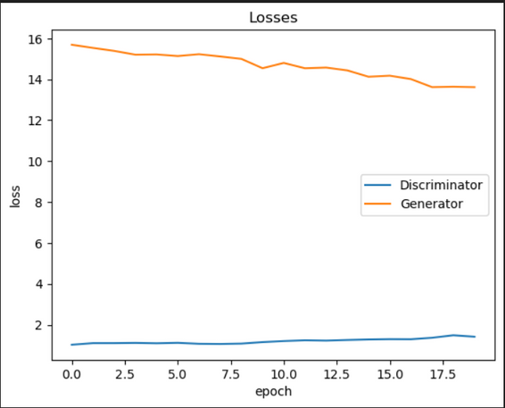
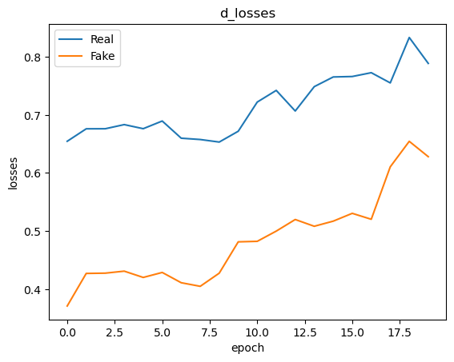
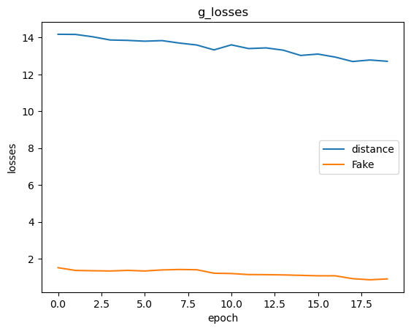
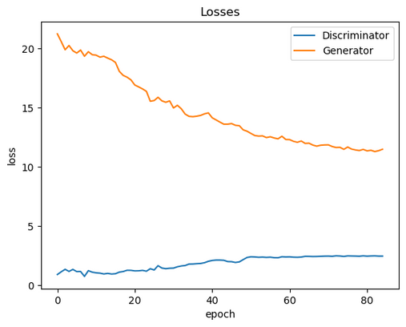
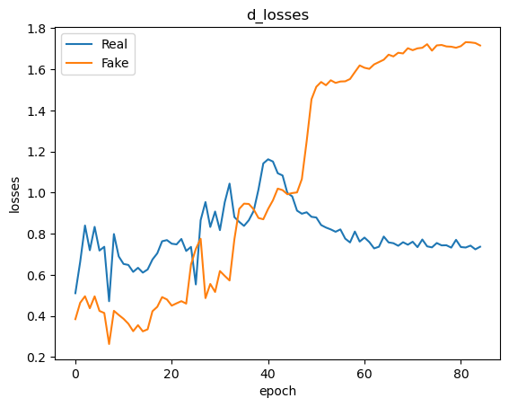
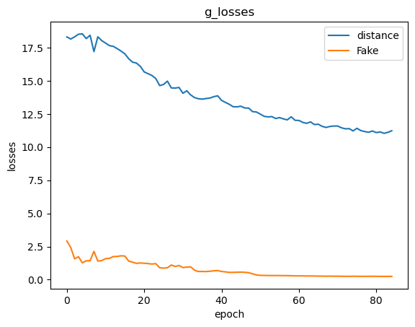
Losses
These data are for 80-100 epochs here it was working well.
data: 160-200 epochs
I had decreased the learning rate of discriminator which describes why fake loss is abruptly increasing.

Slide 13
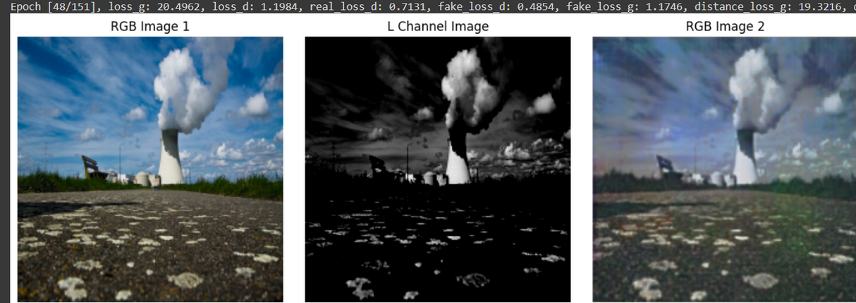
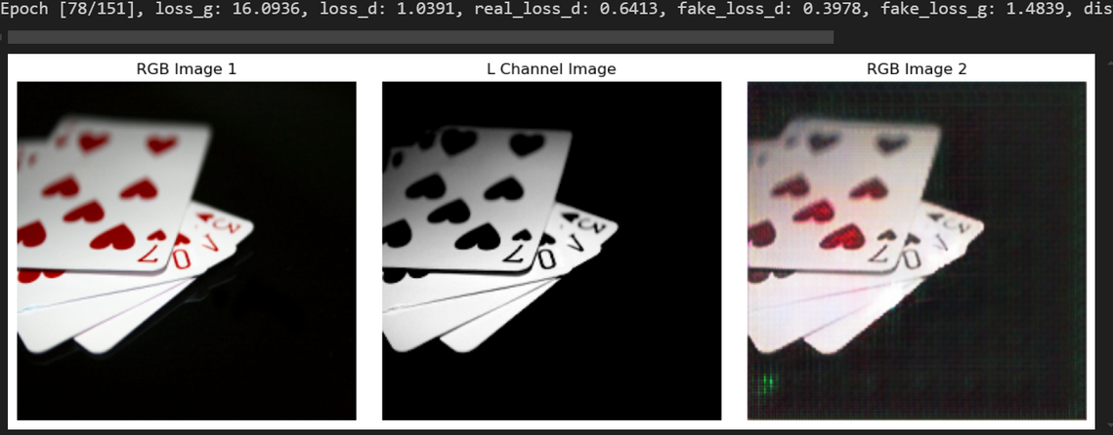
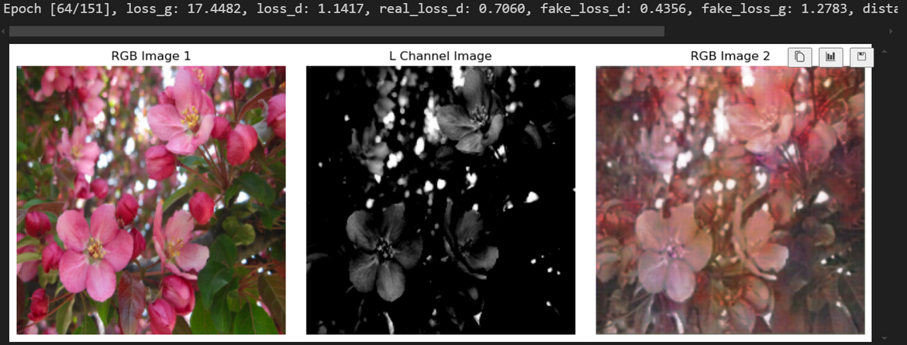
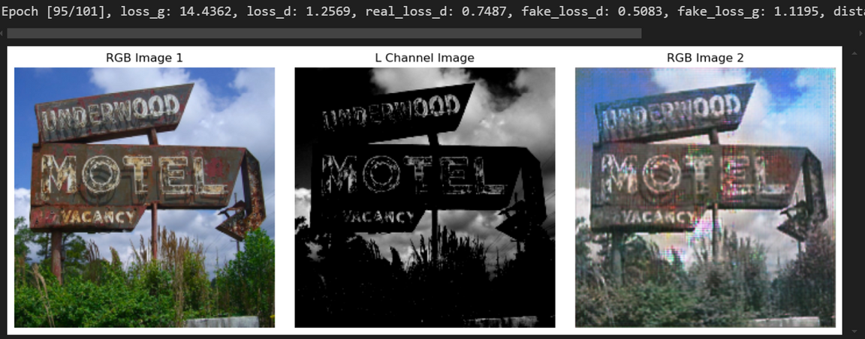
Some Good outputs

Slide 14
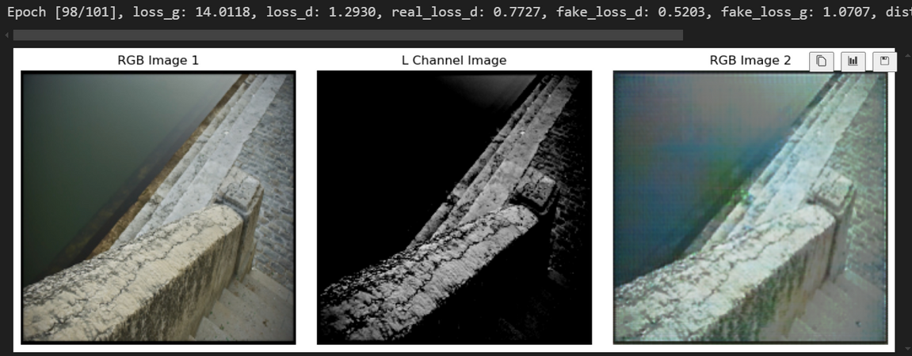
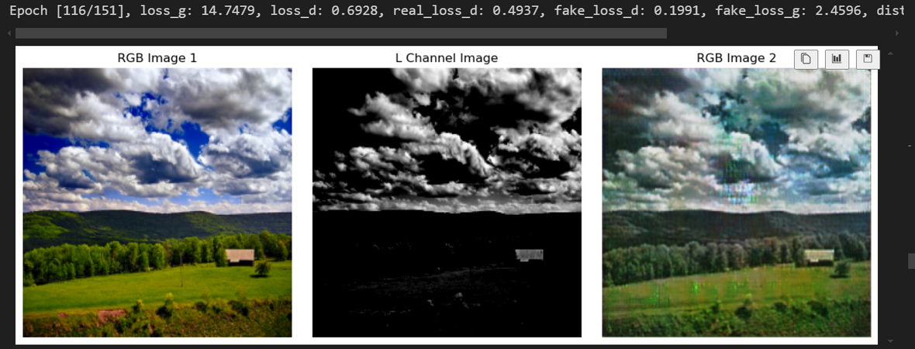
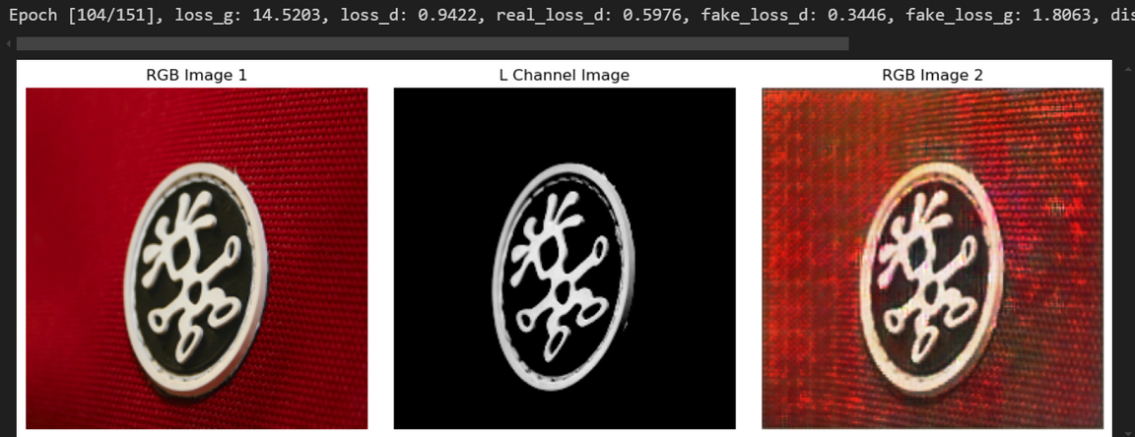
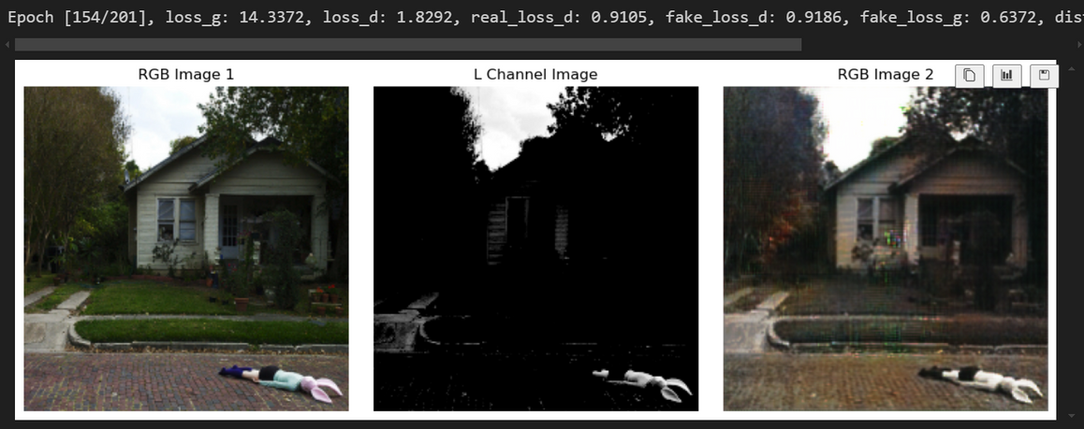
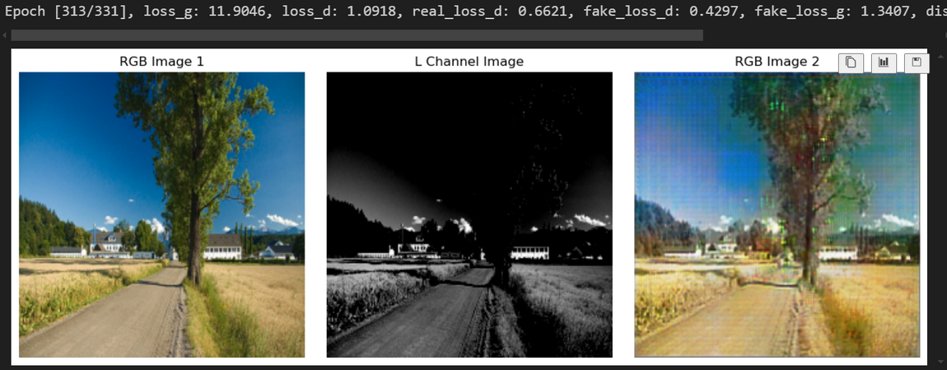
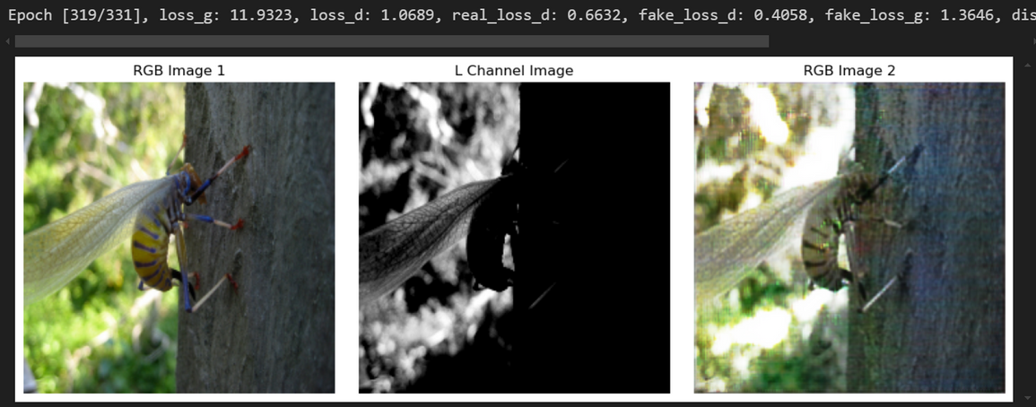

Slide 15
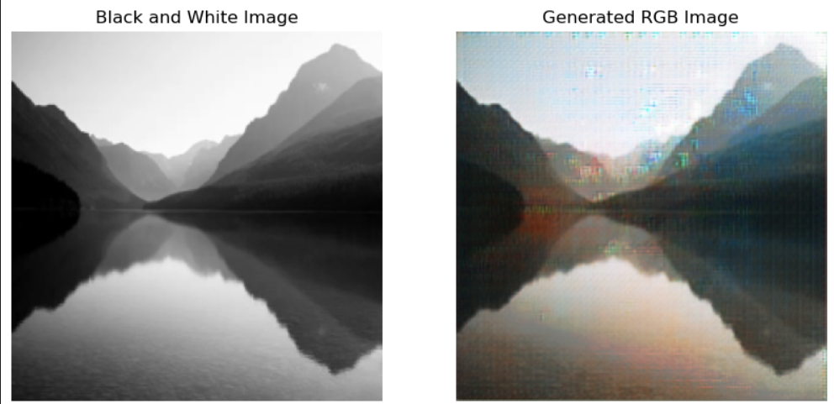
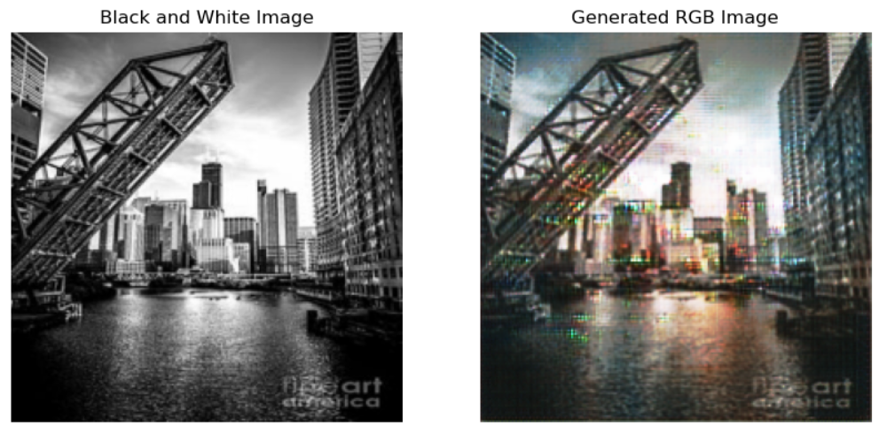
There are more good results but it was working worse in validation images
As you can see it is working well on sky but not in other objects.

Slide 16
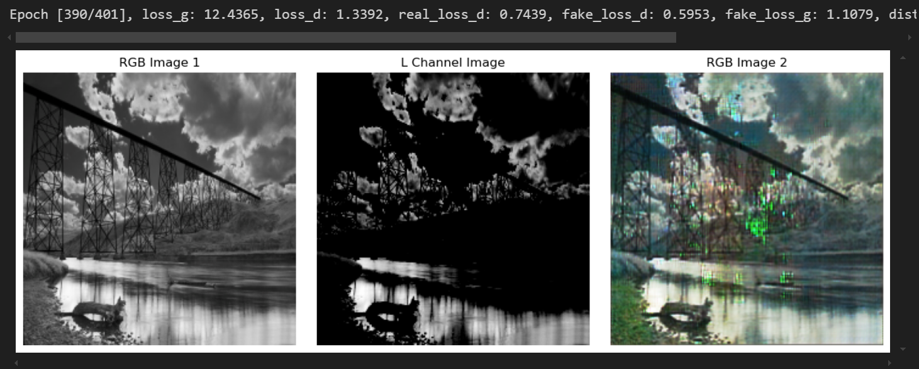
And at some point i started getting repeatedly noise as you can see in this image from what I think generator is fixed in a local minima and couldn’t get any better, I searched how to solve it but I couldn’t get any progress.
From where the kaggle dataset which was taken I saw the other people results I could find only one good result and there was slight difference in our architecture, he was using InstanceNorm2d and dropout in generator, I don’t know why it was working for him.
I researched a lot changing the architecture, lr, but this noise was persistent.

